Slide 1

Developer 2.0 Finding Your Way in the Future of Software Development
Harry Pierson
Microsoft Architecture Strategy Team
Harry.Pierson@Microsoft.com
patterns & practices Summit

Slide 2


Slide 3

The software development market has fundamentally changed
Notes:
The Changing Marketplace
This talk came about because of a conversation I had with Keith Pleas about INETA. He told me that back when INETA first started in 2002 – the tail end of the .com boom – INETA meetings were a place to go and find work. Typically, there were many more people looking for developers than developers looking for work. These days, that trend has reversed itself, along with many other aspects of the software development business.
In the Computerworld annual salary survey [1], there was a dramatic drop in pay raises in the IT sector. After 5 years of better than 5% yearly pay raises (’87-’01), we’ve seen 3% or lower pay raises for the past four years. Furthermore, the average IT worker is working 47 hours a week and over 50% of all IT workers reporting increased workload and budget cuts.
To quote H.I. McDunnough played by Nicholas Cage in Raising Arizona: “I preminisced no return of the salad days.”
[1] http://www.computerworld.com/careertopics/careers/report/0,11188,10242005,00.html

Slide 4

You have to compete against a world-wide market of developers
Notes:
World-Wide Competition
Of course, one of the primary reasons for this change in the software development landscape is due to IT outsourcing and off shoring . According to a NASSCOM-Mckinsey report [1], India’s IT and outsourcing industry is currently worth $22 billion and is expected to grow 25% per year thru the end of the decade. The overall IT outsourcing business in that time is expected to reach $110 billion.
When you consider average salaries in off shore countries, it’s not surprising to see so much work go offshore. Painful perhaps, but not surprising. The average Indian IT worker with 5-8 years experience makes just over 13 thousand dollars per year according to neoIT. That’s around $6.50 an hour, nearly 1/10th the average consultant hourly rate of $61 as reported by the Computerworld annual salary survey [3].
[1] http://www.nasscom.org/artdisplay.asp?Art_id=4782
[2] http://www.neoit.com/pdfs/whitepapers/OIv3i05_0505_ITO-Salaries2004.pdf
[3] http://www.computerworld.com/careertopics/careers/story/0,10801,105580,00.html

Slide 5

Highly-valued skills have become a low-priced commodity
Notes:
The Dropping Value of IT Skills
While software development is dramatically impacted by outsourcing, it’s hardly unique in that regard. Manufacturing jobs have been getting outsourced for over a decade, for much the same reasons IT jobs are being outsourced today. However, this outsourcing phenomenon is a relatively new artifact of our ever shrinking world. However, we’ve seen dramatic skill devaluation before in history, usually at the hands of technology advancement.
For example, “Word Processor” used to be a job title, not a software category.
Another example: chauffeur used to be a highly technical job, back when cars needed daily maintenance. But as cars became more technically advanced and reliable, the technical aspect to the chauffeurs job fell away leaving only the relatively mundane task of driving the car.
Technical advancement also comes to bear in software development. Think about how far the platform has evolved in the past ten years. From programming Windows 95 with C++ to programming Window 2000 with VB6 to programming Windows XP with C# 2.0. Productivity is a primary metric of both platforms and tools. Dramatic improvements in productivity are trumpeted from the highest peaks. Microsoft’s primary marketing pitch for Windows Server is “Do More With Less”. The ASP.NET 2.0 team had a goal of reducing lines of code by 70% over ASP.NET 1.x. And a often-quoted Indigo productivity metric is that to build secure, reliable and transacted web services with the basic .NET platform requires over 55,000 lines of code. With WCF, it’s 3 lines of code.
Not only are we sending jobs overseas, we’re also eliminating them entirely by continuously raising the level of abstraction of the platform and tools. We can expect that, over time, difficult problems become easier and easier and eventually become trivial to solve because of better platforms and tools.

Slide 6

Developing the right skills will let you to stay competitive
Notes:
We’re Accustomed to Change
The good news is workers in the IT industry like yourselves are used to this type of change and re-tooling. The software industry moves at a pace like none others before it. Being successful in this industry means being able to adapt to change rapidly. Within my 7 years at Microsoft, I’ve seen SQL server go from being a non-player in the enterprise database market to the leader in that space. .NET was a gleam in a few people’s eyes when I joined the Microsoft in 1998. Today, it’s become the most popular programming environment around in three short years.
These product market changes imply job market changes as well. Being tied to a specific technology means being out of a job when that technology becomes obsolete.
Change is good. And more importantly, we are good at change.
The question is, what should that change be? If we’re focused on outsourcing, we want to make sure we evolve skills that are less likely to be outsourced. Not all job roles are created equal with respect to outsourcing. For example, locality matters. It may be less expensive to build cars in the far east and then ship them here for sale, but it isn’t efficient to send your car all the way back for an oil change or other service. So while car manufacturing is a skill that is vulnerable to outsourcing, car repair isn’t.
So the real question is, what are the job roles and job skills that are less vulnerable to be outsourced than other. Given that I work for the Architecture Strategy team, you can probably guess what I think.

Slide 7

Focus on architecture so your career can thrive
Notes:
Focus on Architecture
The term “Architecture” varies widely in it’s usage, so let me be crystal clear what I mean when I say “architecture”. To me, architecture is the intersection between business and IT. For example, if you have a list of functional requirements for a new system along with a list of non-functional constraints, building that system is an engineering exercise, not an architectural exercise. Coming up with those two lists in the first place is the architectural exercise. One of the primary roles of the architect is to translate between business speak and IT speak. And that role is getting more and more important every day.
Two years ago, Nicholas Carr raised quite a stir with his article “IT Doesn’t Matter”. As it turns out, it think Mr. Carr is half right. Technology doesn’t matter, but information certainly does. While enterprises have little trouble obtaining technology, knowing what to do with it is another matter entirely. For all the available technology, most organizations have great difficulty harnessing information in order to make better decisions, spend less money and earn more revenue – functions that are absolutely core to the business.
Spending more on technology is easy. Getting more from technology is hard.
That’s where architecture becomes critical. Architecture focuses on the “what” and “why” while engineering and development are concerned with the “how”. And given that most enterprises (i.e. not platform vendors, ISVs or service providers) don’t consider software engineering to be their core competency, engineering jobs are much more likely to be outsourced than architecture jobs.
Outsourcing architecture is like outsourcing business strategy - it’s so core to the business that it can’t be outsourced without the business losing its identity.

Slide 8


Slide 9

Understand the business context in which your technical solution lives
Notes:
Notes:

Slide 10

IT solutions exist solely to support the business

Slide 11

Information technology is creating new business models

Slide 12

Business understanding can’t be easily outsourced

Slide 13


Slide 14

Get inside the mind of your users

Slide 15

Improving the user experience has been under-funded

Slide 16

Users are the primary source of value for the business

Slide 17
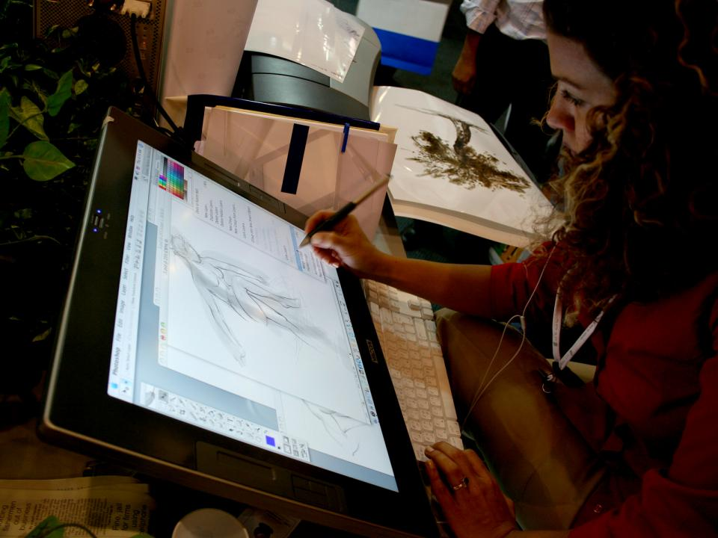
User understanding can’t be easily outsourced

Slide 18


Slide 19

Concentrate on raising the level of abstraction

Slide 20

There’s a large gap between platform capabilities and business need

Slide 21

Bridging that gap requires more than technology skills

Slide 22

Automation understanding can’t be easily outsourced

Slide 23

Can you remain competitive in the new software economy?

Slide 24


Slide 25
Highly-valued skills have become a low-priced commodity
Notes:
If you look at other industries throughout history, this skill devaluation has occurred many times. For example, the vast majority of manufacturing sector jobs has been outsourced to the far east for at least a decade. While this outsourcing phenomenon is a relatively new artifact of our ever shrinking world, other industries have been entirely wiped out by technological advancements.
For example, “Word Processor” used to be a job title, not a software category.
Another example: chauffeur used to be a highly technical job, back when cars needed daily maintenance. But as cars became more technically advanced and reliable, the technical aspect to the chauffeurs job fell away leaving only the relatively mundane task of driving the car.
Technical advancement is also coming to bear in the software development space. Think about how different software development is today in 2005 than five years ago, or five years before that. The difference between ASP.NET and ASP, between C# and VB.net compared to C++ and Classic VB, between the capabilities provided by Win32 and WinFX.
Not only are we sending jobs overseas, we’re also eliminating them entirely by continuously raising the level of abstraction of the platform and tools.
Over time, difficult problems become easier and eventually trivial to solve with better and better tools.

Slide 26
Developing the right skills will let you to stay competitive
Notes:
The good news is workers in this industry like yourselves are used to this type of change and re-tooling. The software industry moves at a pace like none others before it. Being successful in this industry means being able to adapt to change rapidly. Within my 7 years at Microsoft, I’ve seen SQL server go from being a non-player in the enterprise database market to the leader in that space. .NET was a gleam in a few people’s eyes when I joined the Microsoft in 1998. Today, it’s become the most popular programming environment around in three short years.
Change is good. And more importantly, we are good at change.
The question is, in what direction should we go now? What should we focus on in order to enable our careers to continue to evolve?
Given that I work for the Architecture Strategy team, I’m guessing you already know what my advice is.

Slide 27

Find your way in the future of software development

Slide 28

Make architecture the next step in your career

